Slide 1
ATOM (SOURCE CODE AND TEXT EDITOR)
GROUP MEMBERS:
23k-3032
23k-3008

Slide 2
HISTORY
DEVELOPED BY: Git-Hub(Branch of Microsoft)
RELAESED DATE: 26 February 2014.
STABLE DATE: 23 OCTOBER 2019
USED AS AN IDE(INTEGRATED DEVELOPMENT ENVIRONMENT~
integrated development environment(IDE) is a software
application that provides complete facilities to computer
programmers for software development.

Slide 3
Introduction
It is a free and open source text and source code editor.
It is a desktop application built by using web technologies.
Supported by Mac’s, Android and Windows.
Atom is based on (ELECTRON) formerly known as Atom Shell),a framework that enables cross-platform desktop applications using Chromium(browser) and node.js(JavaScript code outside of a browser).

Slide 4
PROGRAMMIING LANGUAGE SUPPORT
Atom's default packages can apply syntax highlighting for the following programming languages and file formats:
Bash C C++ Clojure
COBOL CSS CoffeeScript D
Go HTML Java JavaScript
JSON Julia Mustache Objective-C
Perl PHP Property lists Python
Racket Ruby Ruby on Rails Rust
Sass Scala SQL TOML
TypeScript XML YAML MML

Slide 5
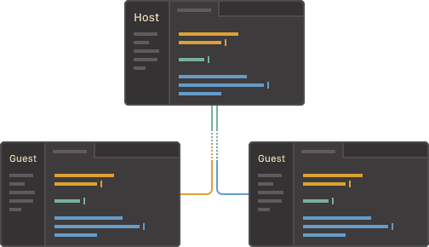
Working on code together in real time is valuable for knowledge sharing and producing quality software. The Teletype package for Atom aspires to make it as easy for developers to code together as it is for them to code alone.Teletype introduces the concept of real-time "portals" for sharing workspaces. When a host opens a portal, their active tab becomes a shared workspace. There, invited collaborators can join in and make edits in real time.
Real Time Portals:

Slide 6
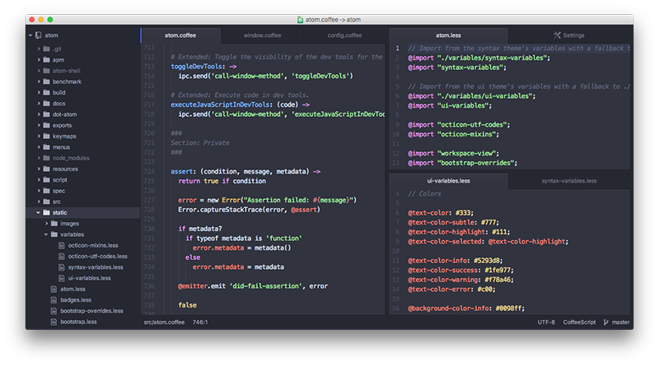

Slide 7
Multiple Cursor:
One of the most impressive features of Atom is its multiple cursor support. This enables to you type many things at once, on multiple lines, anywhere in the document. Just hold cmd (Mac) or ctrl (Windows/Linux) and click in every place you want to type.

Slide 8
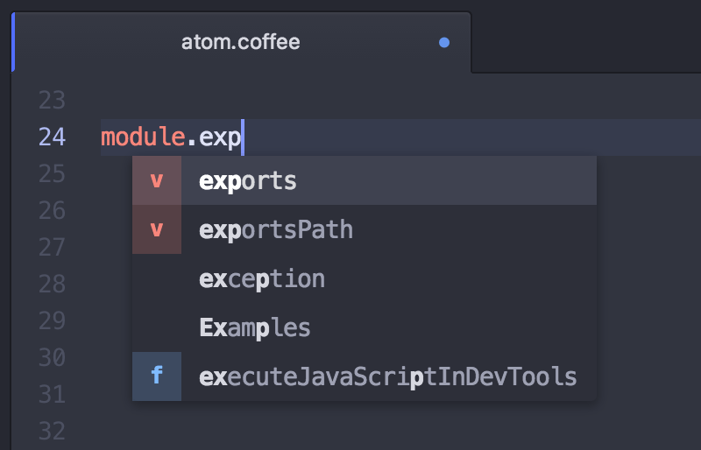
Smart Autocompletion:
If you're still looking to save some typing time, Atom also ships with simple autocomplete functionality.The autocomplete system lets you view and insert possible completions in the editor using Tab or Enter.By default, the autocomplete system will look through the current open file for strings that match what you're starting to type.

Slide 9
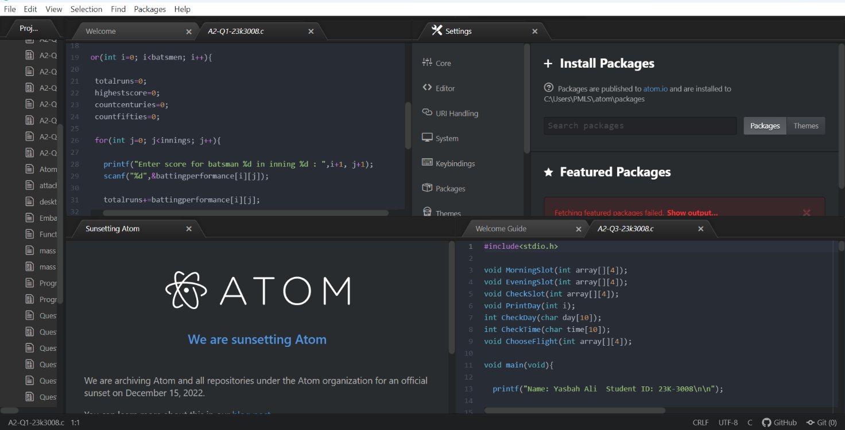
Multiple panes:
You can split any editor pane horizontally or vertically by using Ctrl+K Up/Down/Left/Right where the direction key is the direction to split the pane. Once you have a split pane, you can switch between them with Ctrl+K Ctrl+Up/Down/Left/Right where the direction is the direction the focus should move to.

Slide 10
PACKAGE MANAGER:
Package is a collection of software tools.
It automates the process installing, upgrading, configuring , and removing computer program for computer operating system.
It deal with packages , distributions of software and data in archive files.

Slide 11
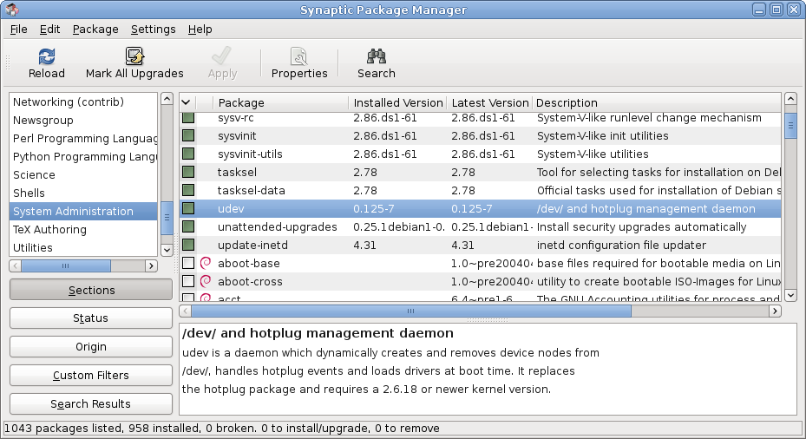
SYNAPTIC PACKAGE MANAGER

Slide 12
LIST OF PACKAGE MANAGER
Binary Packages
UNIX LIKE
Linux 2. Mac OS 3. BSD
MOBILE
Android 2.Mobile
SOURCE CODE BASED
Mac OS(OS X)
Windows

Slide 13
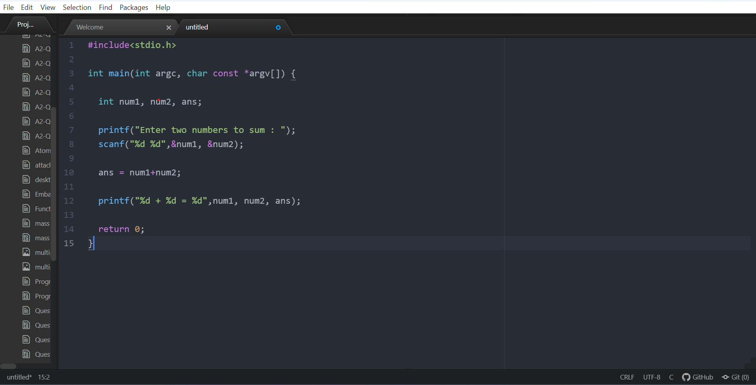
Sample code on atom

Slide 14
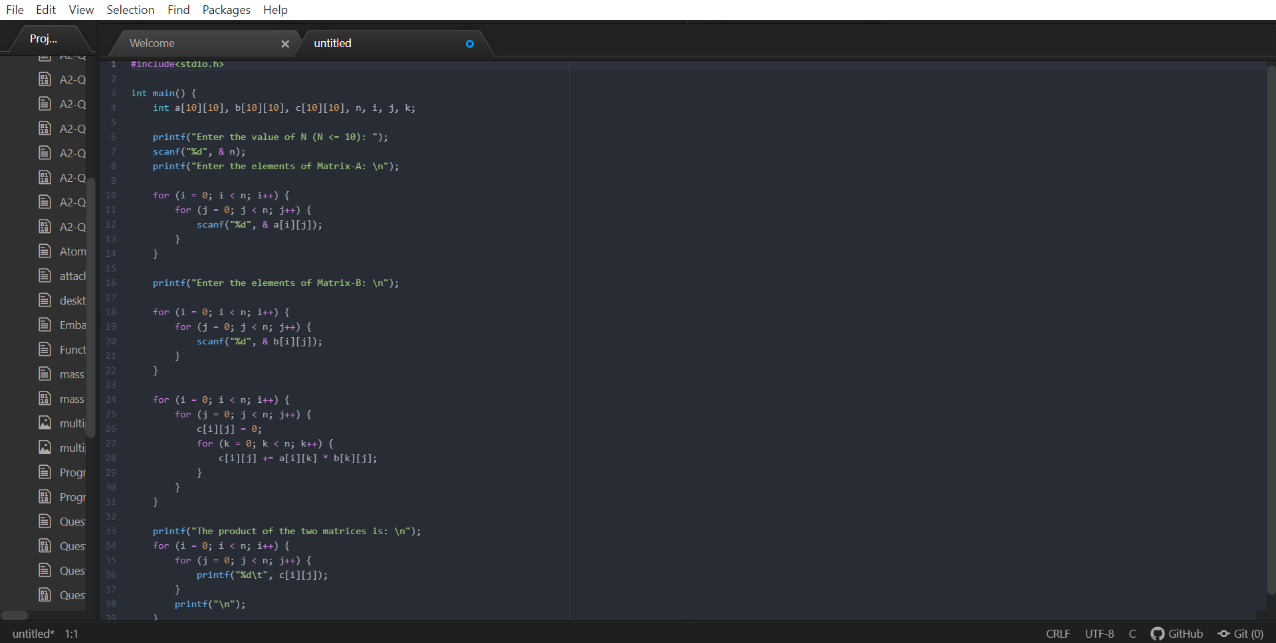

Slide 15
THANK YOU!

